Slide 1

EXAMINATION MANAGEMENT SYSTEM
PROJECT DEVELOPED BY:
KARTIK ARORA – 2132015
ROHAN SHARMA – 2000184
ROHIN BIYAL – 2000185
RUDRA PRATAP SAMAL - 2000189
DESIGNED IN PYTHON AND ORACLE

Slide 2
INTRODUCTION
This project aims at building an Examination Management System. It is divided into different modules to make it more user-friendly.
This project has been developed to override the problems of prevailing in the practicing manual system.
This software is supported to eliminate and reduce the hardships faced by the existing system.
The purpose of the Examination Management System is to automate the existing manual system by the help of the computerized equipment and full-fledged computer software, fulfilling their requirements so that the valuable data/information can be stored for a long period with easy accessing and manipulation of the same.

Slide 3
FUNCTIONALITIES OF THE SYSTEM
Manages the users such as DEOs, Evaluators and Admins, only by authorized access.
Manages the data/information of the students (Roll no., Name, Course, Semester and their results)
Adding, Updating and Deletions are possible in different modules according to the necessities.
To increase the efficiency of managing the exams and results in an institution.

Slide 4
FEATURES OF THE SYSTEM
Authorized LogIn can create, update or delete the users presently working with the system.
Authorized LogIn also has full access of all the modules which again gives it full authorization to add, update or delete in students, subjects, exams and result related details.
This system is built for only for the users who will manage the pre-examination data and post-examination data.

Slide 5
Pre-examination refers to selection of subjects and generation of date-sheets of the examination for each course and semester currently present.
Post-examination refers to generation of marks and results of each student, maybe based upon MCQs which can use OMR to generate result, or descriptive examination which needs to upload result manually by DEO.
For pre-examination, if any changes in subjects or date-sheets need data to be updated which is already stored, then only Admins with any designation of the institution will have right to do so.
For post-examination, if anyhow result which is stored or marks which are generated are not valid or need to be changed, authorized LogIn like DEOs with any designation of the Institute can update the data.

Slide 6
All users are provided a feature to update their profile to some extent.
Whereas Admin with any designation, of the Institute can update the details of the other users which are not accessible by those.
Each module provides a well design to show, create, update and delete the contents related to the relations required in this system, whereas some modules don’t have few feature like creating and deleting content such as creating subjects or deleting students’ details.
The Main Window may supposed to have one Mask Layer Button which will mask the whole window for the user, if it is needed and then it can only be unmasked if provided right credentials (password) for that User.

Slide 7
Date-sheet Generator is an excellent feature of this system where any user with Admin role can generate date-sheets of each semester with one click.
Marks/Result Viewer is another feature of this system where user will be provided with graphical views of any student, class, branch, course or semester results and may have feature to project out that views.
The Marks/Result Views may use Bars representation, Pie representation or even basic Table representation according to the user needs.
The Marks/Result generator may use both OMR Scanner and Manual Data Entry, or only one of these, for generating each student’s result.

Slide 8


TOOLS BEING USED FOR DEVELOPING THE SYSTEM
PyQt5 – PYTHON LIBRARY
For Front-end development
ORACLE
For Back-end data handling

Slide 9
MODULES PRESENT IN THE SYSTEM
MODULES
PROFILE
MANAGE USER
STUDENT DATABASE
COURSE / SUBJECT
DATESHEET
RESULT / MARKS
Edit Profile
Create User
Show Student
Show Subject
Generate Datesheet
Upload Marks
LogOut
Show User
Show Datesheet
Show Result
Update User
Update Datesheet
Update Result
Delete User

Slide 10
TABLES BEING USED IN THE SYSTEM
USER’S TABLE
Containing details about all the users present who can retrieve or manipulate data from other tables
And this table is only accessible by user - SUPERVISOR
STUDENT TABLE
Containing details about all the students enrolled in the institution
COURSE/SUBJECT TABLE
Containing the details about all the subjects in each semester of every course
DATESHEET TABLE
RESULT/MARKS
Containing details about the exam’s datesheet which has been generated by any Admin
Containing details about the marks of the students which would be used to generate result according to the user’s need

Slide 11
STRUCTURE OF THE TABLES WHICH ARE BEING USED TO STORE DATA

Slide 12
USER TABLE
USERNAME
varchar2
PASSWORD
varchar2
NAME
varchar2
DESIGNATION
varchar2
ROLE
CONTACT
varchar2
unique
primary key
not null
not null
not null
not null
number
COLUMN NAME
DATA TYPE
CONSTRAINT

Slide 13
STUDENT TABLE
ROLLNO
number
SNAME
varchar2
COURSE
varchar2
SEM
number
BATCH
number
primary key
not null
not null
check sem (between 1 and 8)
check (batch> 2000)
COLUMN NAME
DATA TYPE
CONSTRAINT

Slide 14
COURSE/SUBJECT TABLE
Each semester of each course will have one different table
SUB
varchar2
SUBCODE
varchar2
not null
primary key
COLUMN NAME
DATA TYPE
CONSTRAINT

Slide 15
DATESHEET TABLE
Each course will have one datesheet table for one time
DATE
date
SUB
varchar2
SUBCODE
varchar2
not null
not null
references subject (subcode)
COLUMN NAME
DATA TYPE
CONSTRAINT

Slide 16
RESULT/MARKS TABLE
Each semester of each course will have one result table for every batch
ROLLNO
number
SUBCODE1
number
SUBCODE2
number
SUBCODE3
number
SUBCODE4
SUBCODE5
number
check (subcode5<=100)
references student (rollno)
check (subcode1<=100)
check (subcode2<=100)
check (subcode3<=100)
check (subcode4<=100)
number
TOTAL
number
check (total<=100)
COLUMN NAME
DATA TYPE
CONSTRAINT

Slide 17
PROJECT UI EXPERIENCE

Slide 18
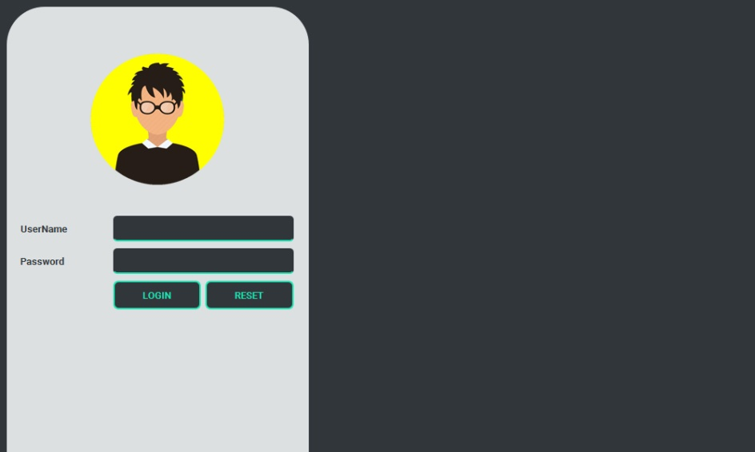
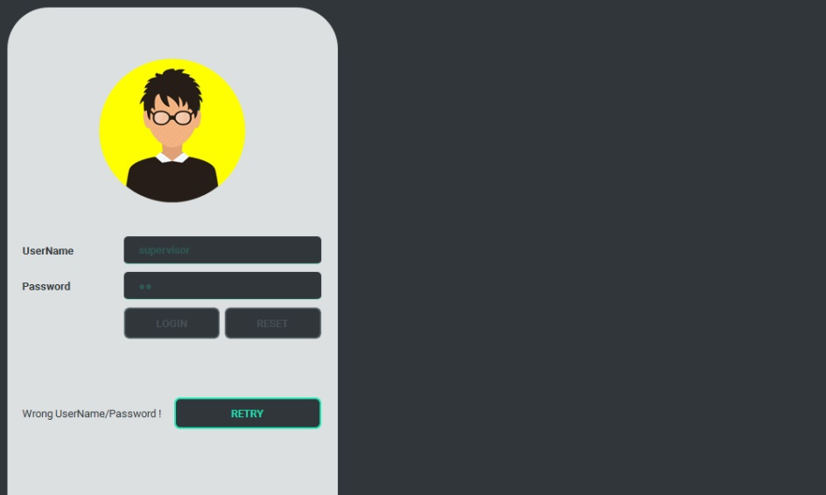
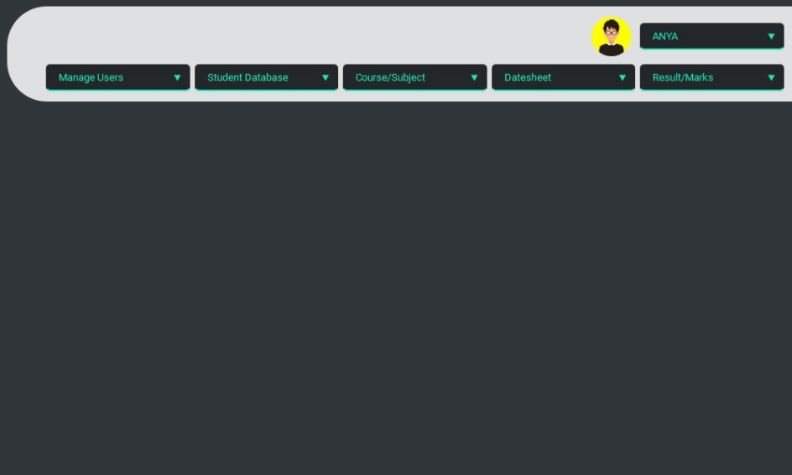
LOGIN

Slide 19
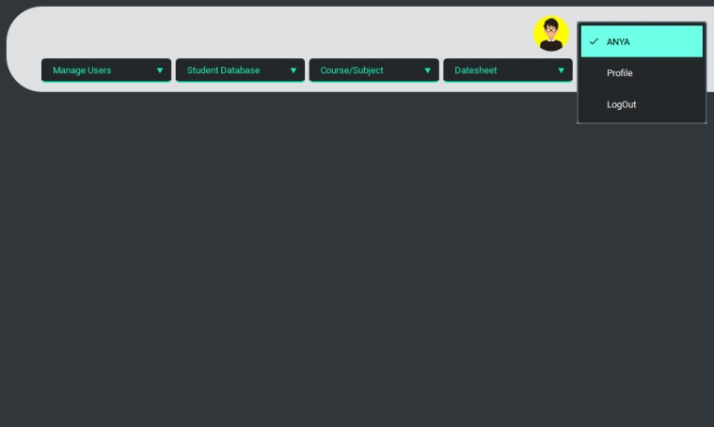
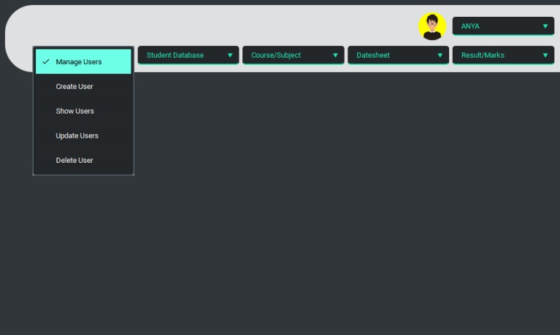
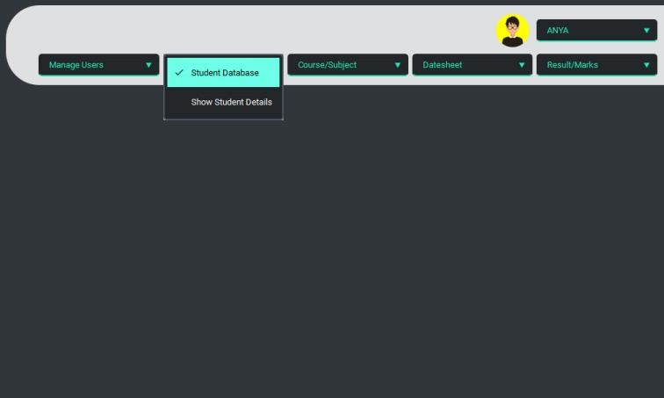
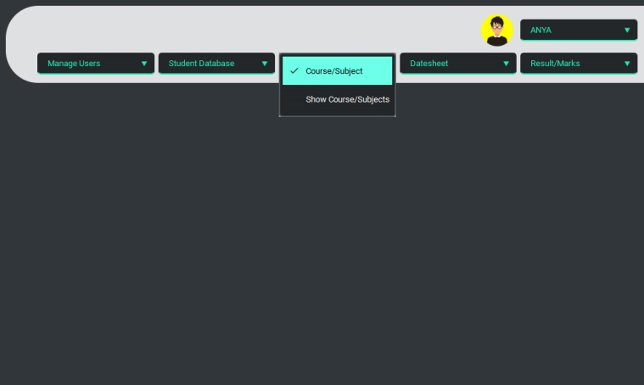
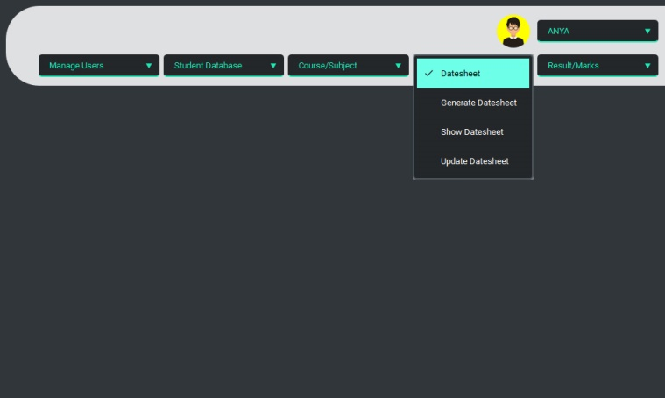
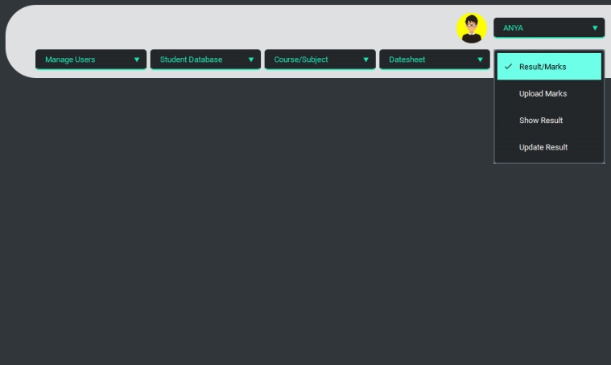
SYSTEM MENU

Slide 20
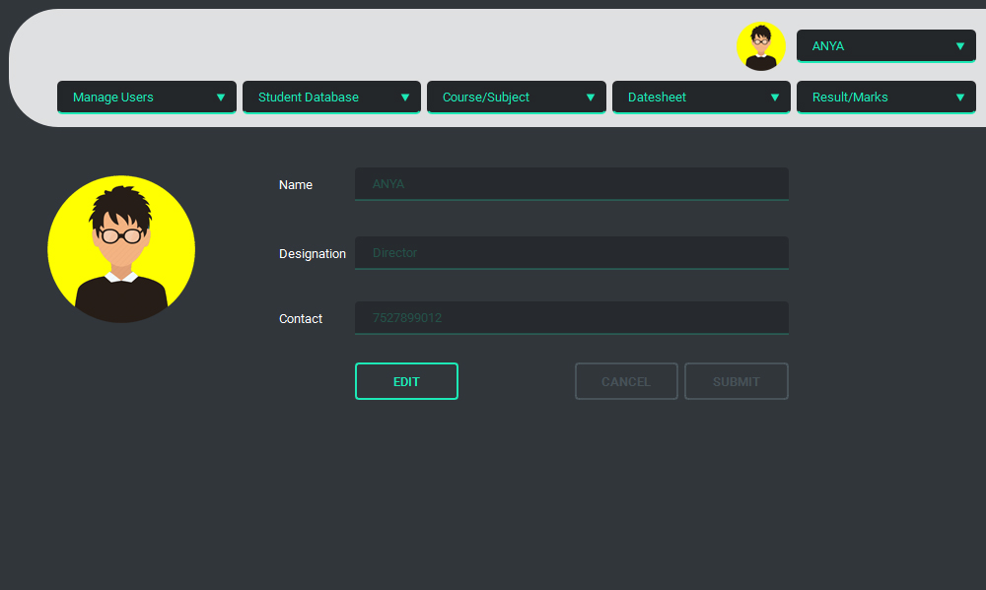
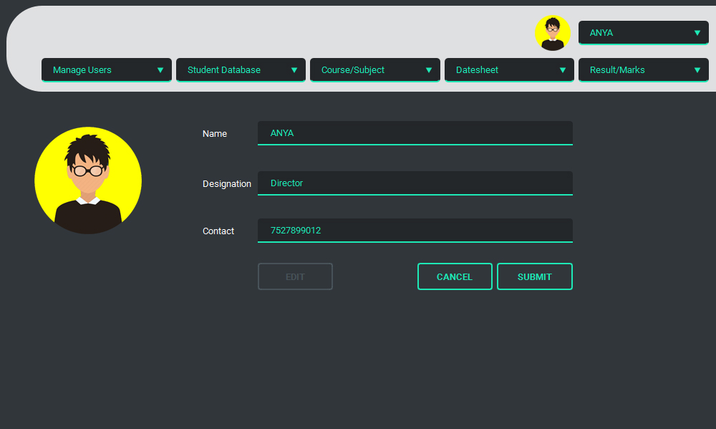
PROFILE

Slide 21
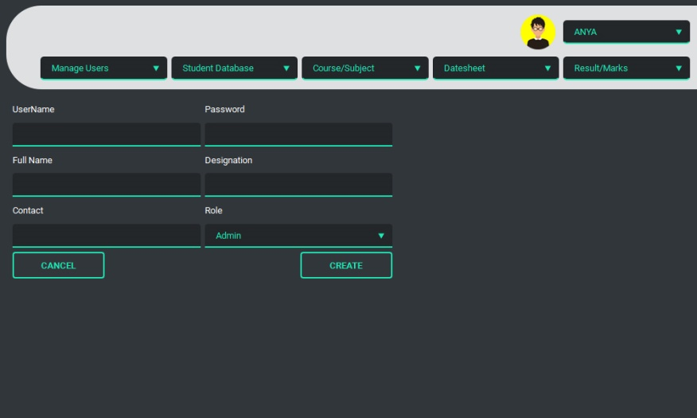
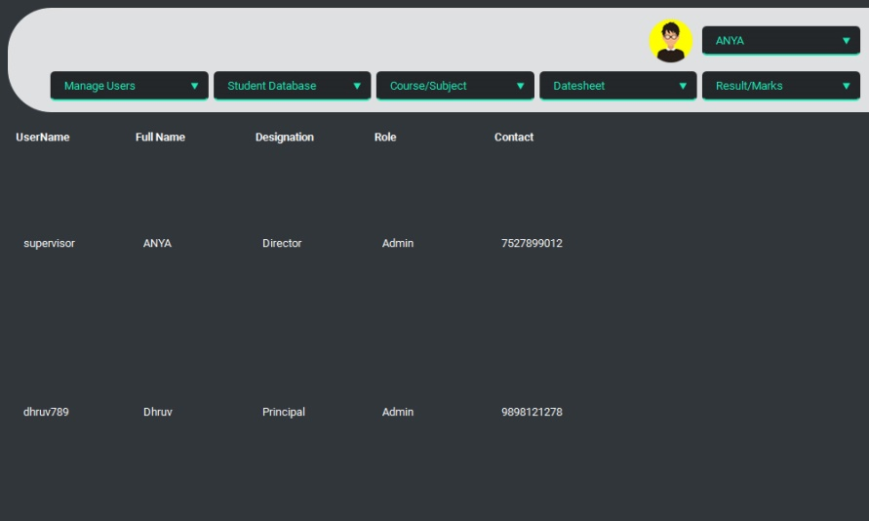
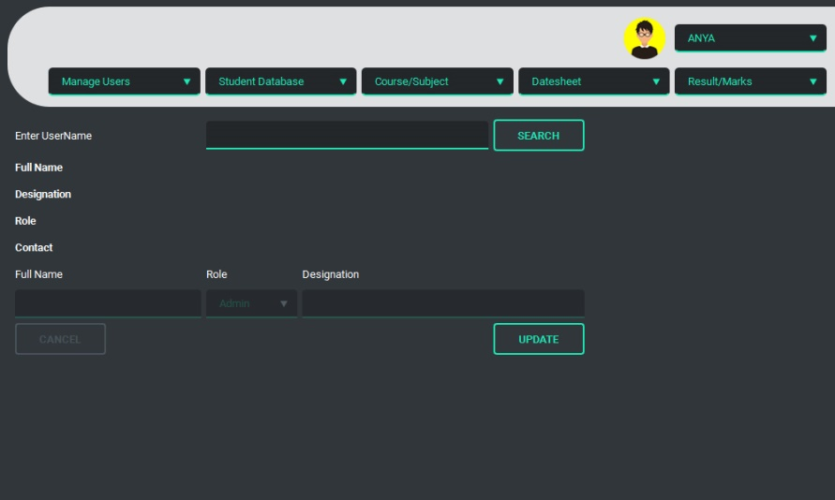
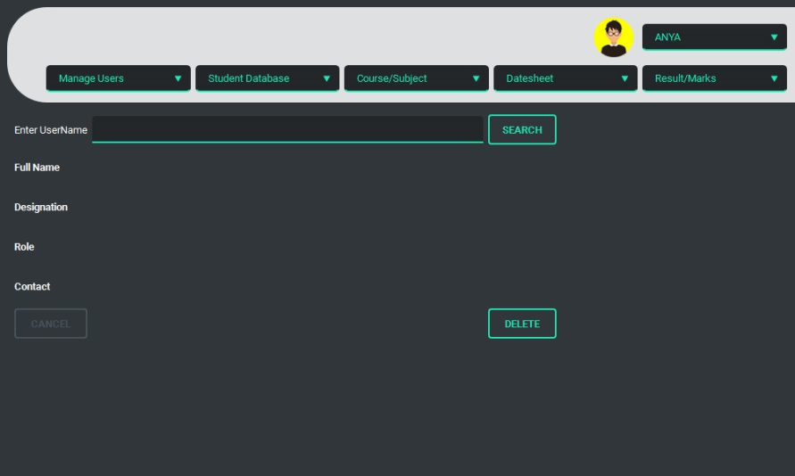
MANAGE USERS

Slide 22
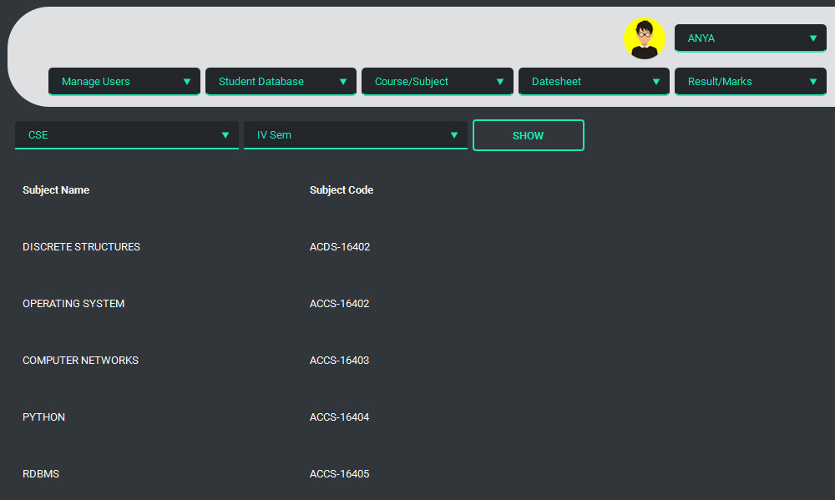
COURSE/SUBJECT

Slide 23
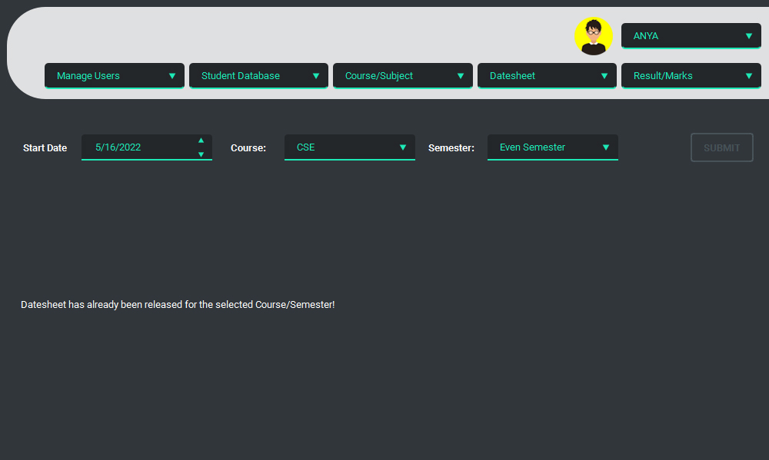
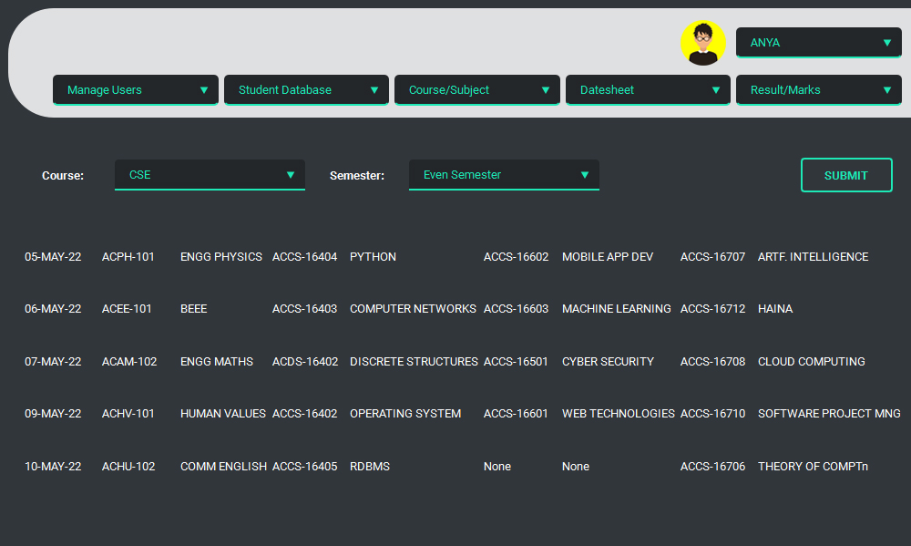
DATESHEET GENERATOR

Slide 24
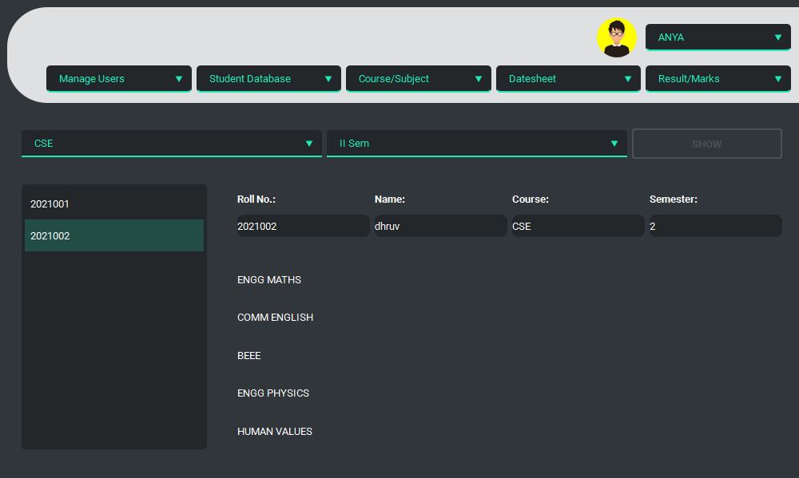
RESULT/MARKS

Slide 25
THANKS!

